Slide 1
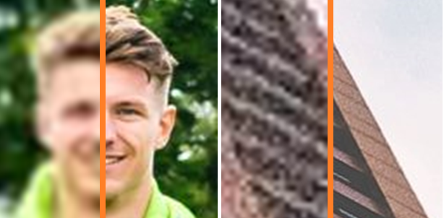
A Closer Look at the Developments of Super Resolution
erhtjhtyhy
Credit to Christian Galea’s Towards Data Science article
“Image Super-Resolution: An Overview of the Current State of Research”
Alexander Nishio
ADVISOR
Purdue University
Seongha Park

Slide 2
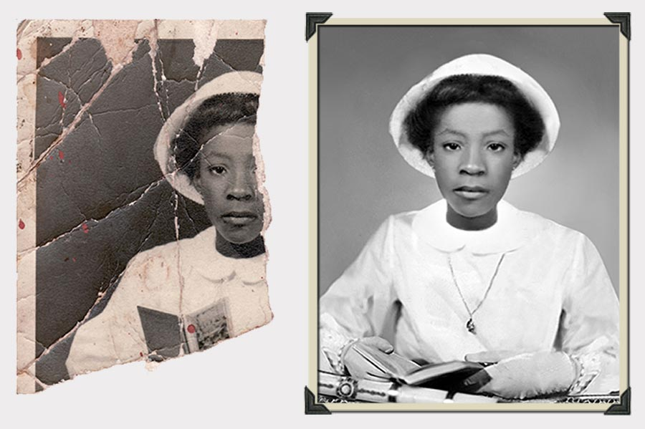
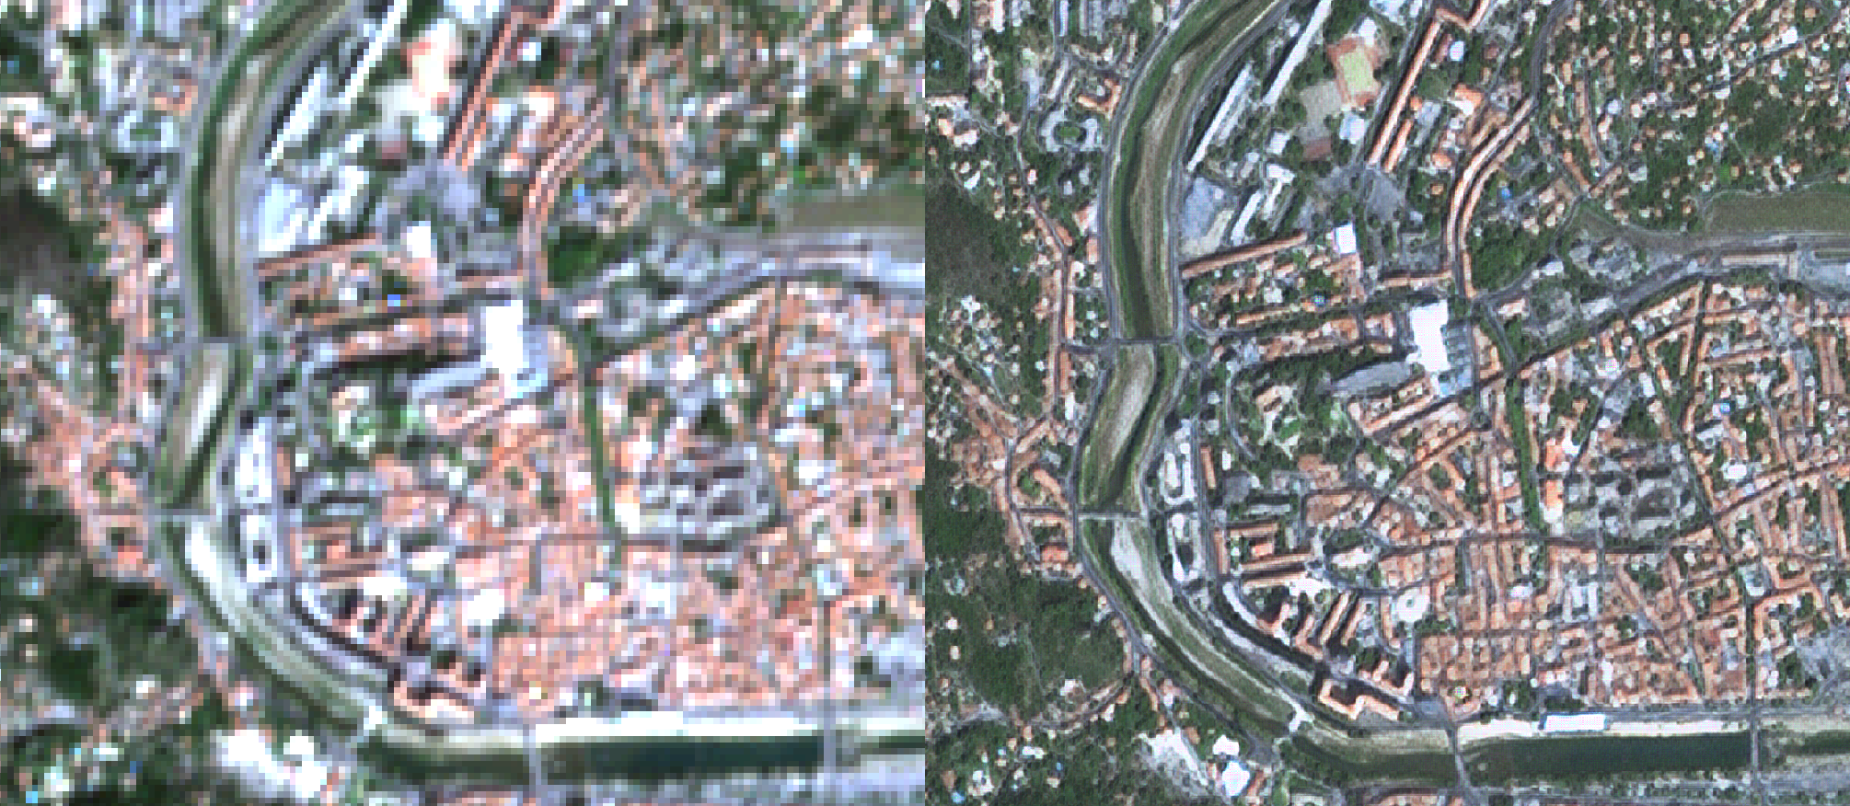
Background
Credit to Phojoe’s article: Photo Restoration
Credit to Rémi Cresson’s mdl4eo article
“Enhancement of Sentinel-2 images at 1.5m”

Slide 3
Overview of Models

Slide 4
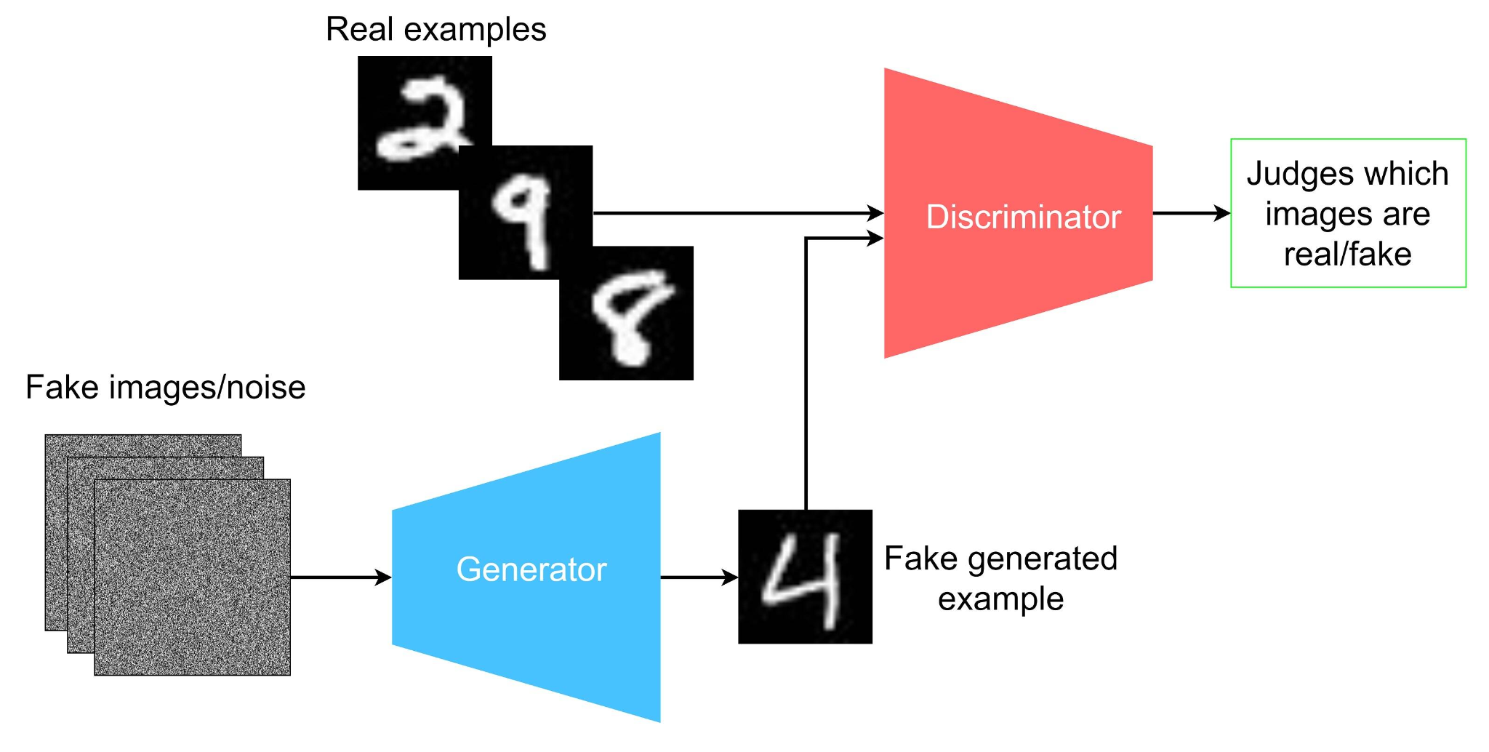
Generative Adversarial Models (GAN Models)
Credit to Caper Hansen’s IBM Developer article
“Generative adversarial networks explained”

Slide 5
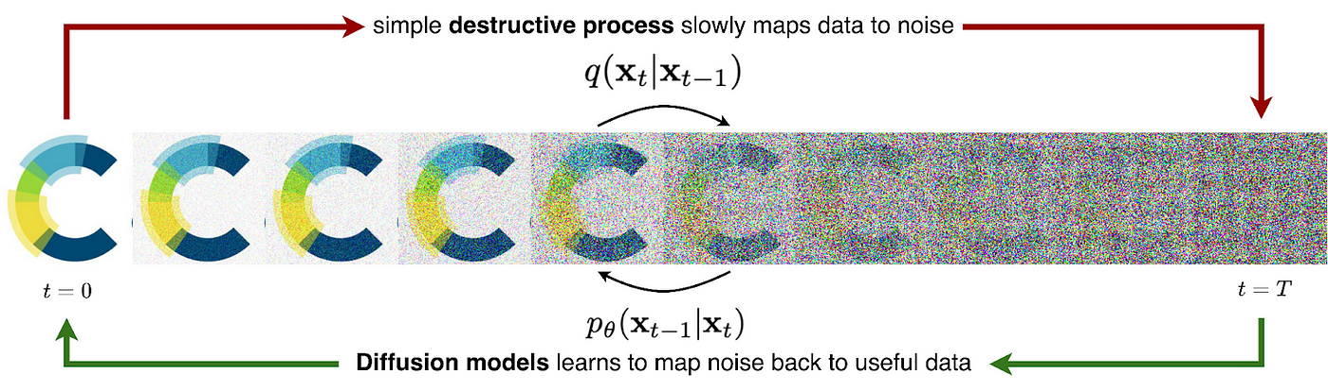
Diffusion Models
Credit to Charlie Harris’ Medium Article
“Diffusion Models in Generative Chemistry for Drug Design”

Slide 6
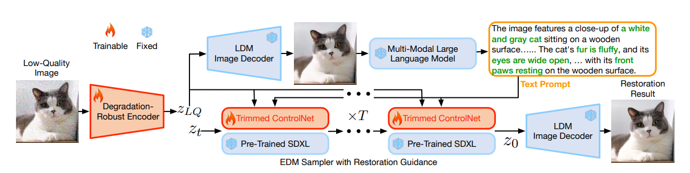
Diffusion Model (SUPIR’s method)
Encoder Decoder: Input and Output Source
SDXL: StableDiffusion Model
ControlNet: Controls Diffusion Models
Multi-Modal Model: Outputs text describing a given image
Credit to XPixel Group’s Supir Research Paper

Slide 7
Results

Slide 8
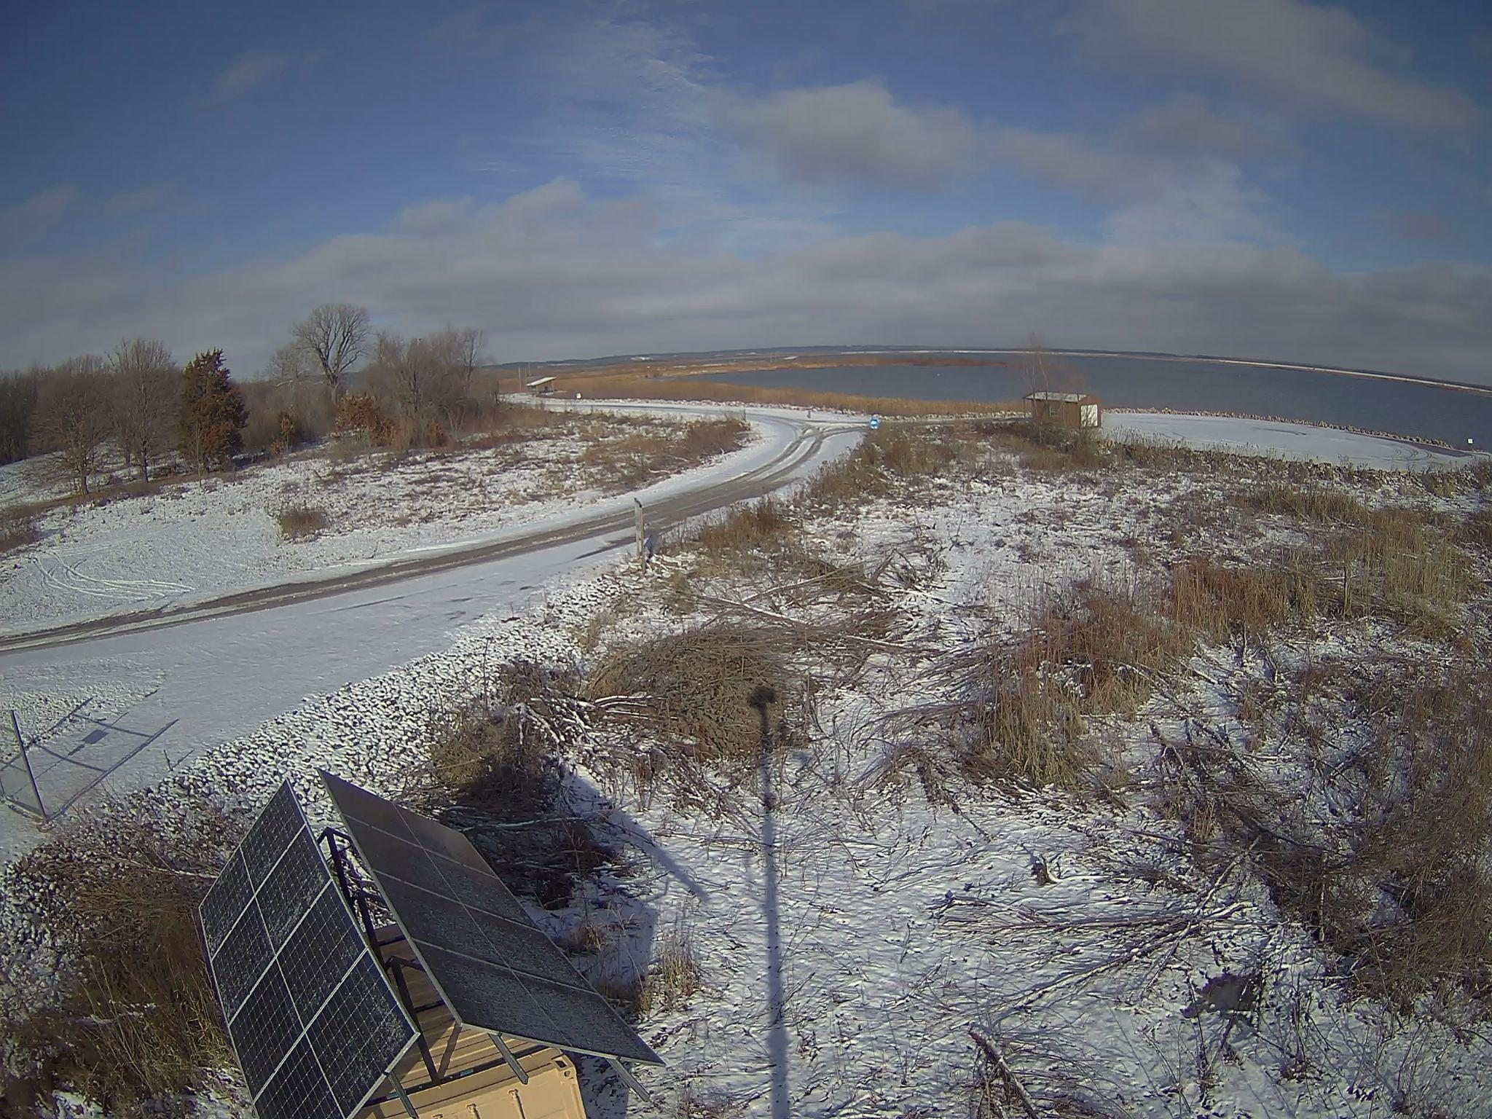
Input: 232x145
Sage Node Sample Image

Slide 9
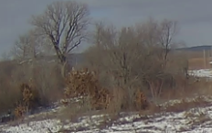
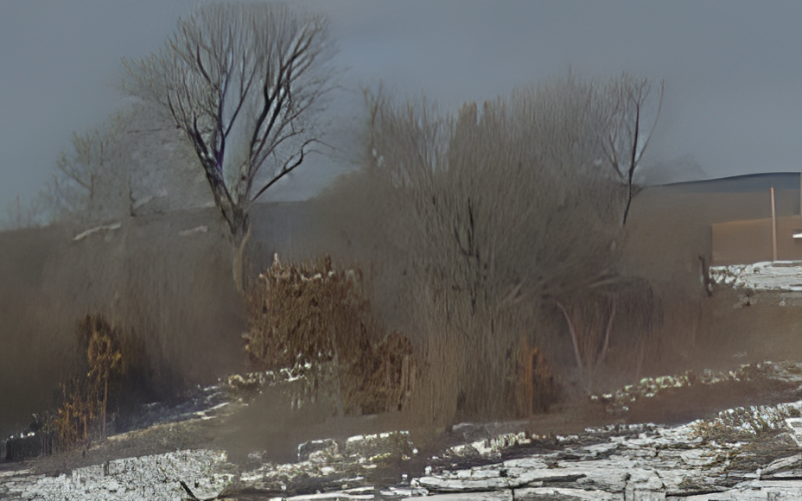
Input
Real-ESRGAN
< 10 seconds

Slide 10
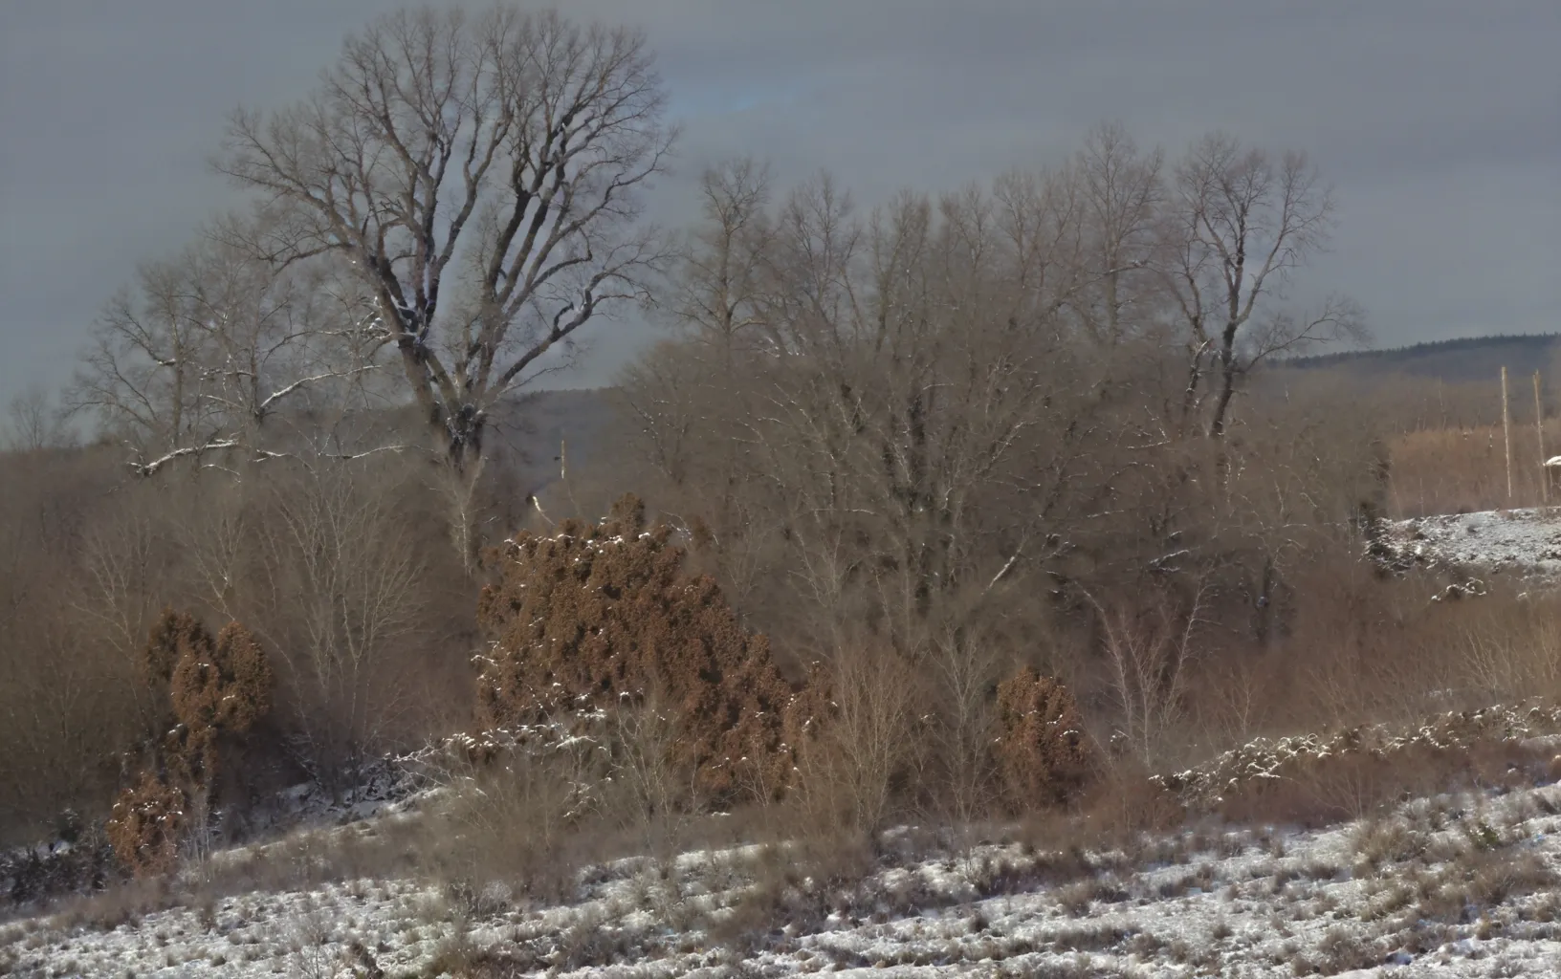
Prompt: A snowy landscape with a bushes and trees nearby
Input
SUPIR
100 secs

Slide 11
Input: 164x146

Slide 12
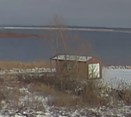
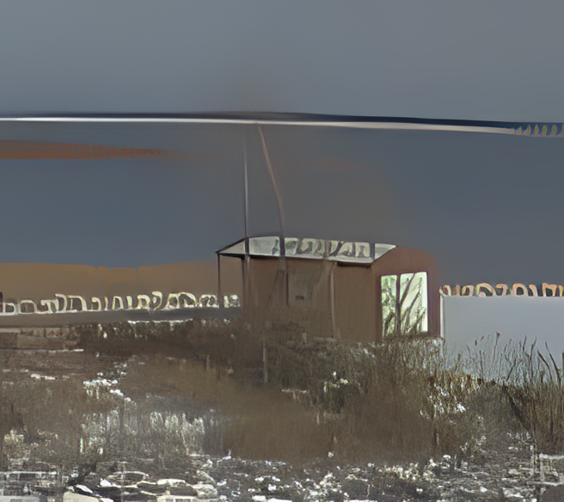
Input
Real-ESRGAN
< 10 seconds

Slide 13

Prompt: Red shed with tree in front on a snowy island and ocean scenery in back
Input
SUPIR
67 secs

Slide 14
Input: 220x190

Slide 15
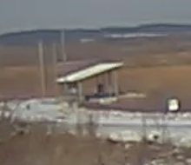
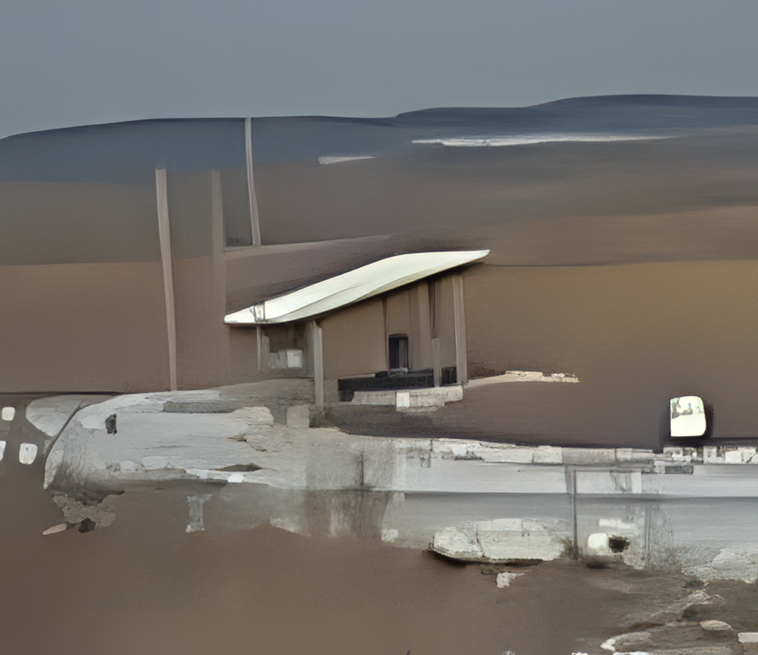
Input
Real-ESRGAN
< 10 seconds

Slide 16

Prompt: A road surrounded by grass leading to a bus stop.
Input
SUPIR (with prompt)
68 secs

Slide 17
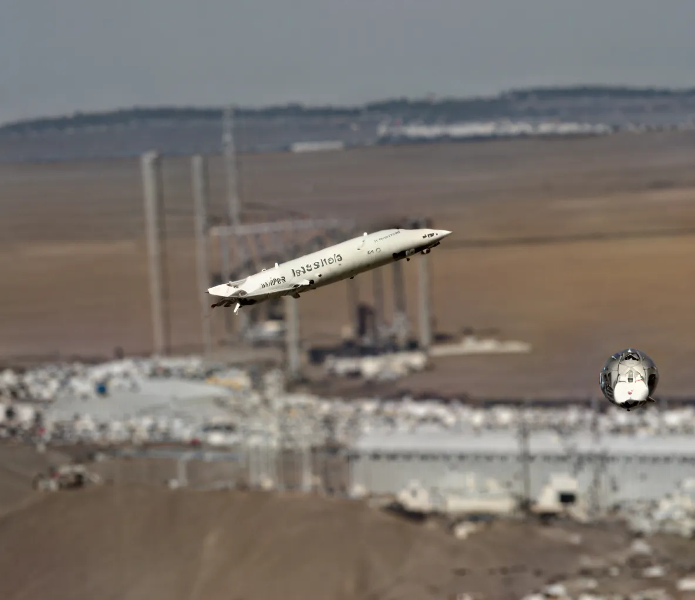
Input
SUPIR (without prompt)
68 secs

Slide 18
Summary of Findings

Slide 19
SUPIR vs Real-ESRGAN
Advantages of Real-ESRGAN:
Small model (<1 GB)
Requires <1 GB of VRAM
Runs on CPU as well
Fast compute time
Deployable on Edge
Disadvantages of Real-ESRGAN
Poor results if the image quality is too small
Image enhancement is not very apparent

Slide 20
SUPIR vs Real-ESRGAN
Advantages of SUPIR:
Image enhancement is much more powerful compared to Real-ESRGAN
Disadvantages of SUPIR:
Extremely large model (30-40 GB)
Requires GPU
Inefficient for large batch sizes
Poor results if no text provided
Poor at rendering text

Slide 21
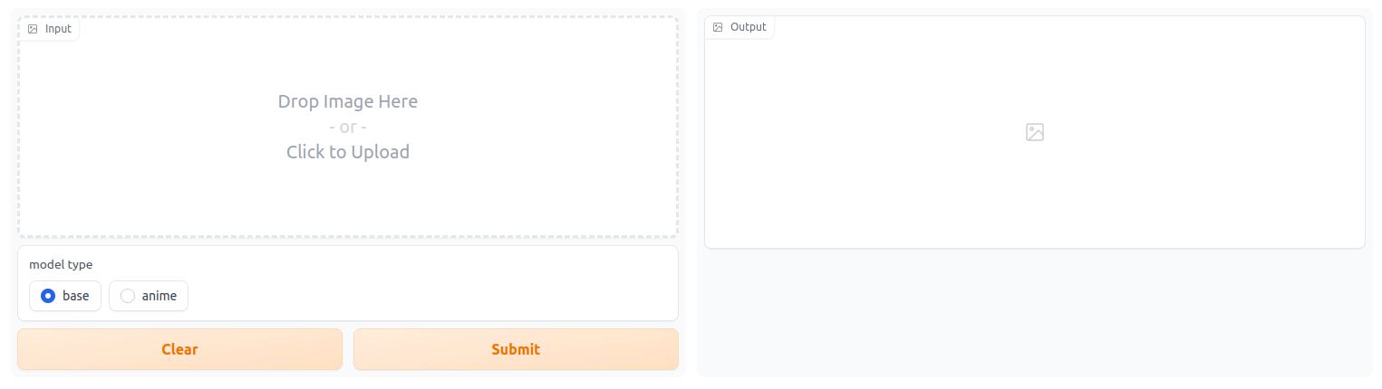
Next Steps
Finish the deployment of models onto the Sage Nodes
Implement a Slack Bot
Create a Web Interface / Gradio for more customization

Slide 22
Thank you!

